Slide 1
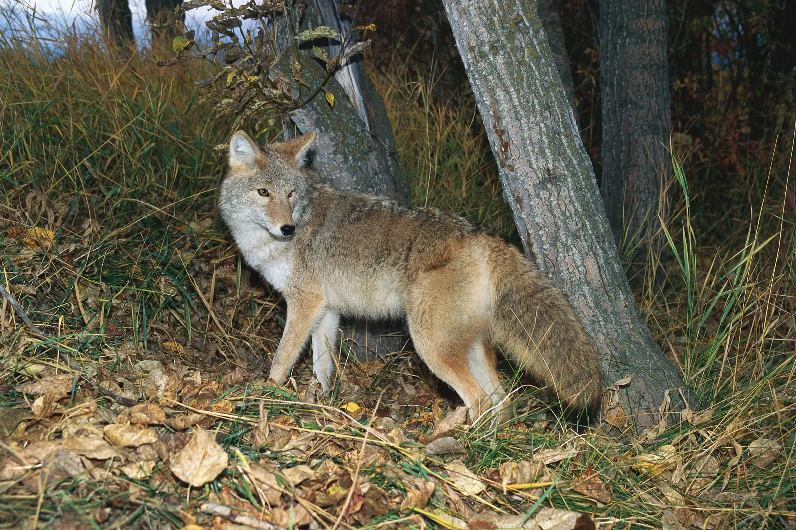
Developing Thematic Maps of Coyote Distributions in Texas Using ChatGPT
Patrick Bailey & Patrick Cunningham
Bio 5100
Photo: Britannica, 2024

Slide 2
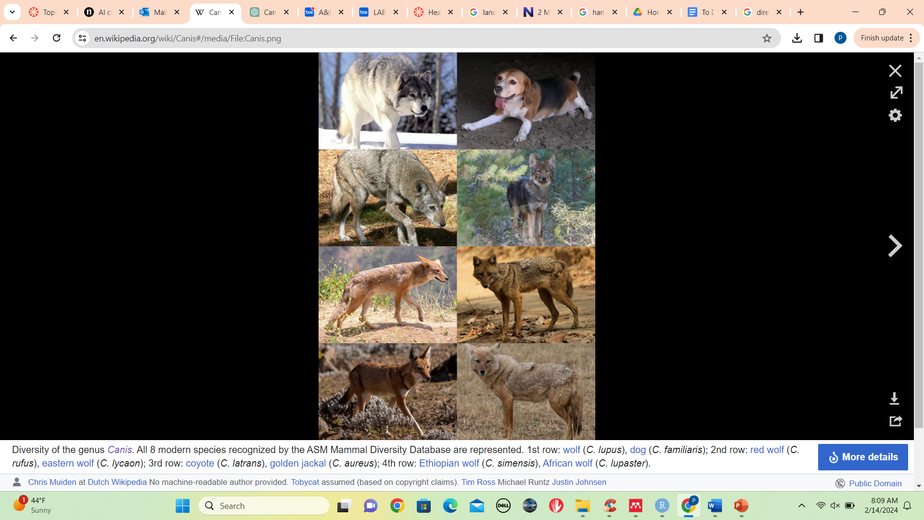
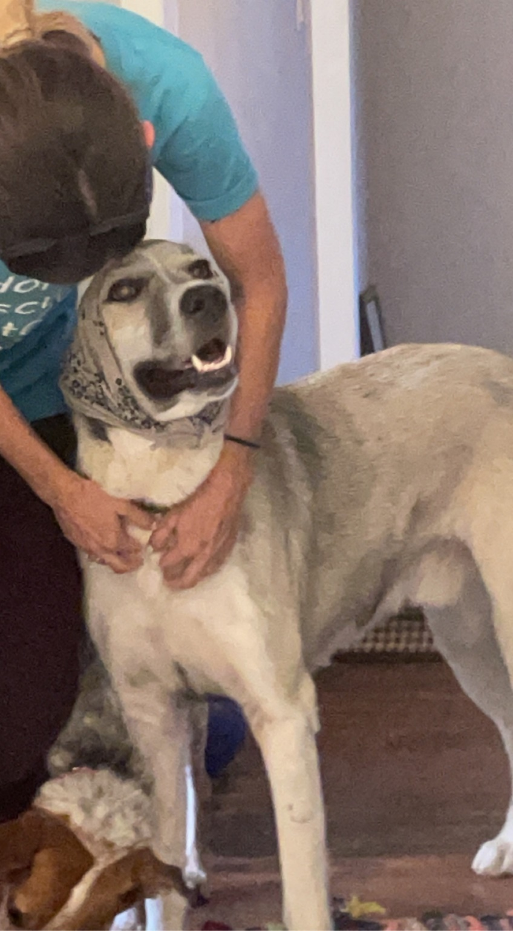

https://en.wikipedia.org/wiki/Canis
Notes:
How did we go from THIS to THIS?
Self-domestication hypothesis is one explanation
Animals that risked associating with humans benefited from high resource availability
Still not “proven”, but coyotes provide good example of how this may have happened

Slide 3
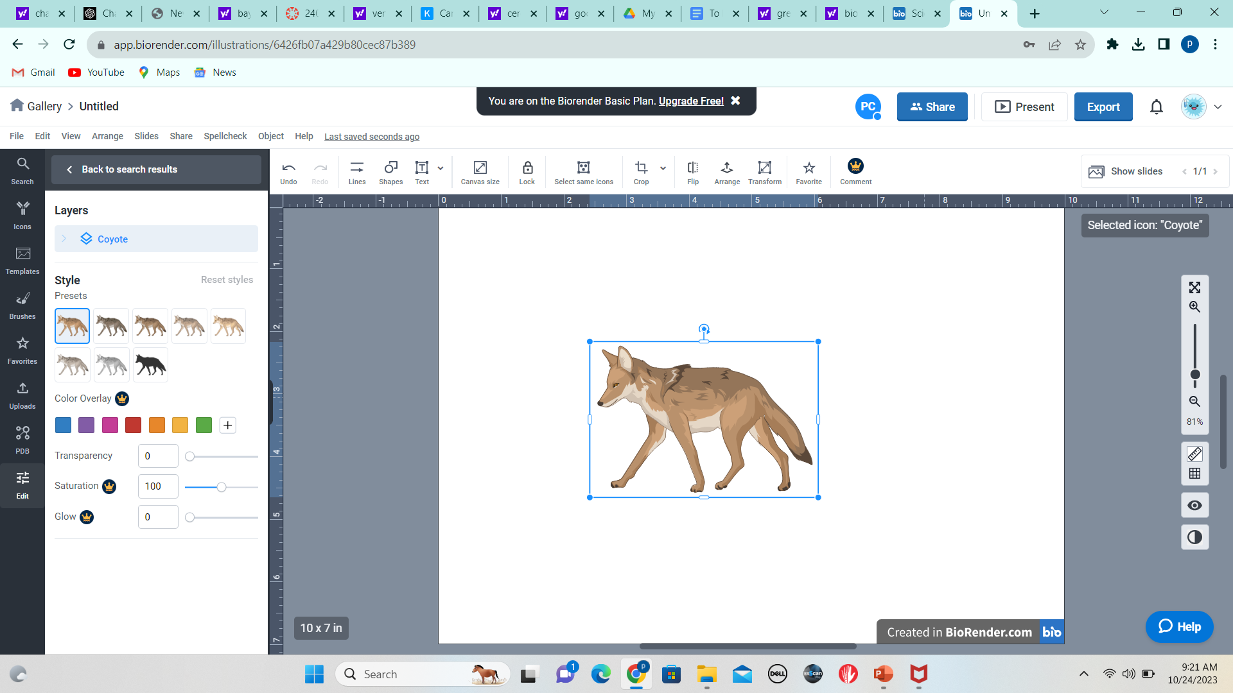
Background
Rural
Urban
How does the risk – reward relationship associated with urban vs rural habitats influence the stress physiology of coyotes?
Increased:
-Resource availability
-Behavioral indicators of boldness
-Pup survival
-Mortality from vehicle collision
Decreased:
-Territory size
-Mortality from hunting/trapping
Notes:
In order to test this, we gotta designate coyotes as either urban or rural…

Slide 4
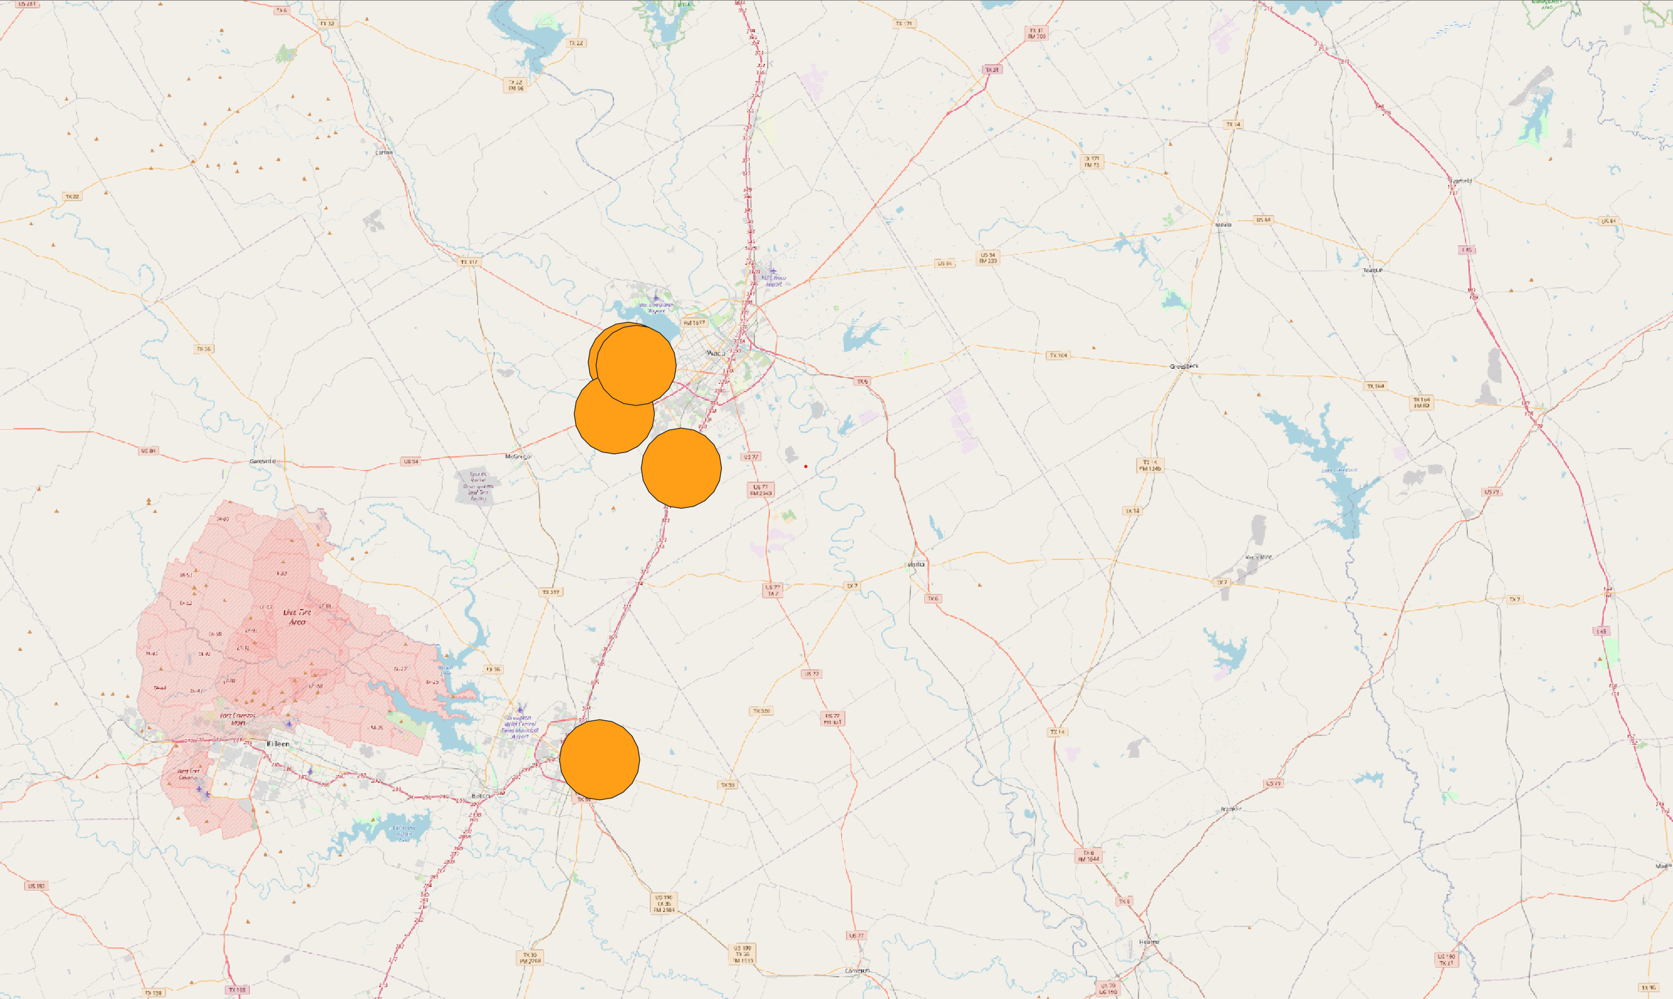
Final Goal

Slide 5
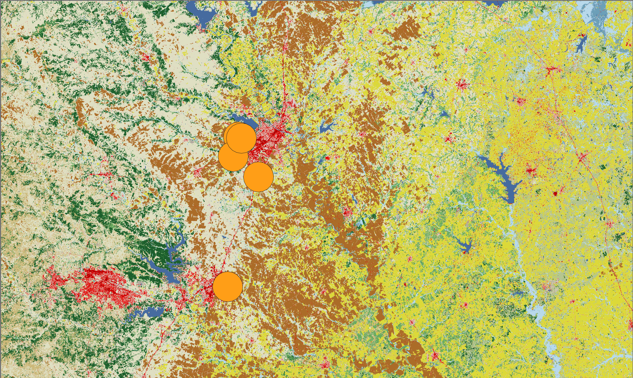
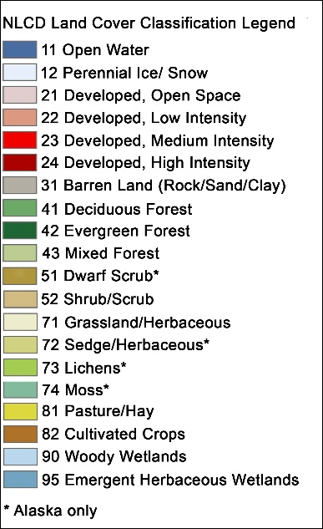
Final Goal

Slide 6
ChatGPT framework
Move to next step / improve visualization
PASS
Specify packages Manual dataset
Specify functions / break up input
Specify packages Manual dataset
Specify packages
No restrictions
Error checking via ChatGPT
FAIL
Revise prompt

Slide 7
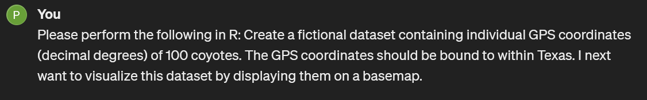
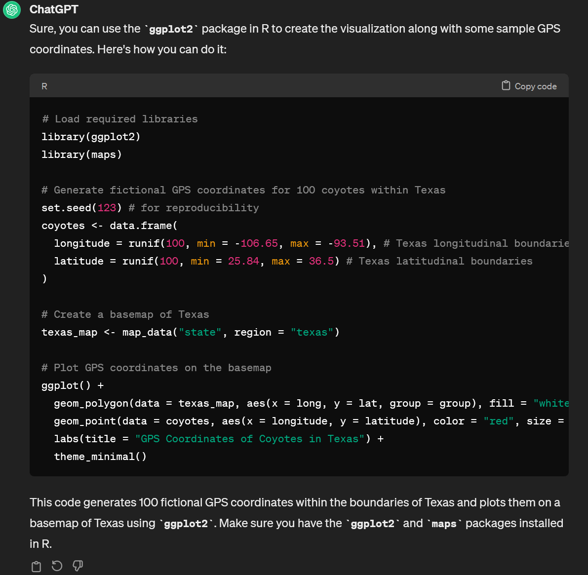
Chat GPTAttempt #1 – No restrictions
Prompt
Response

Slide 8
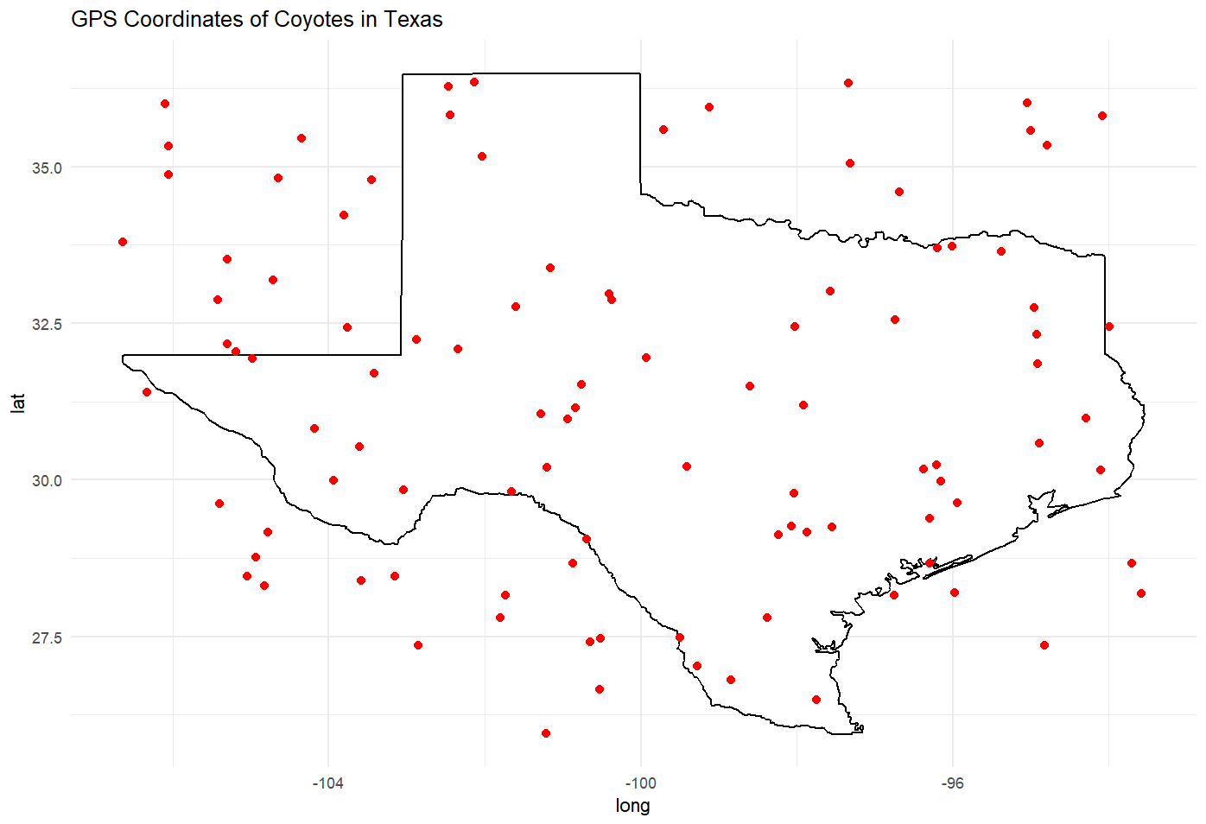
Chat GPTAttempt #1 – No restrictions
Problems:
-GPS extent incorrect
-Ugly!

Slide 9
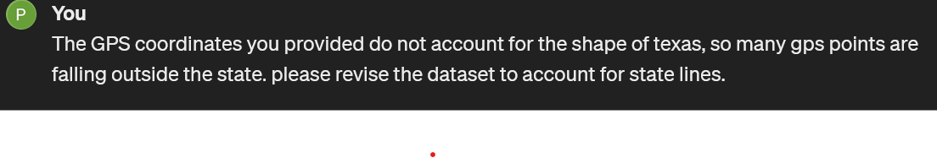
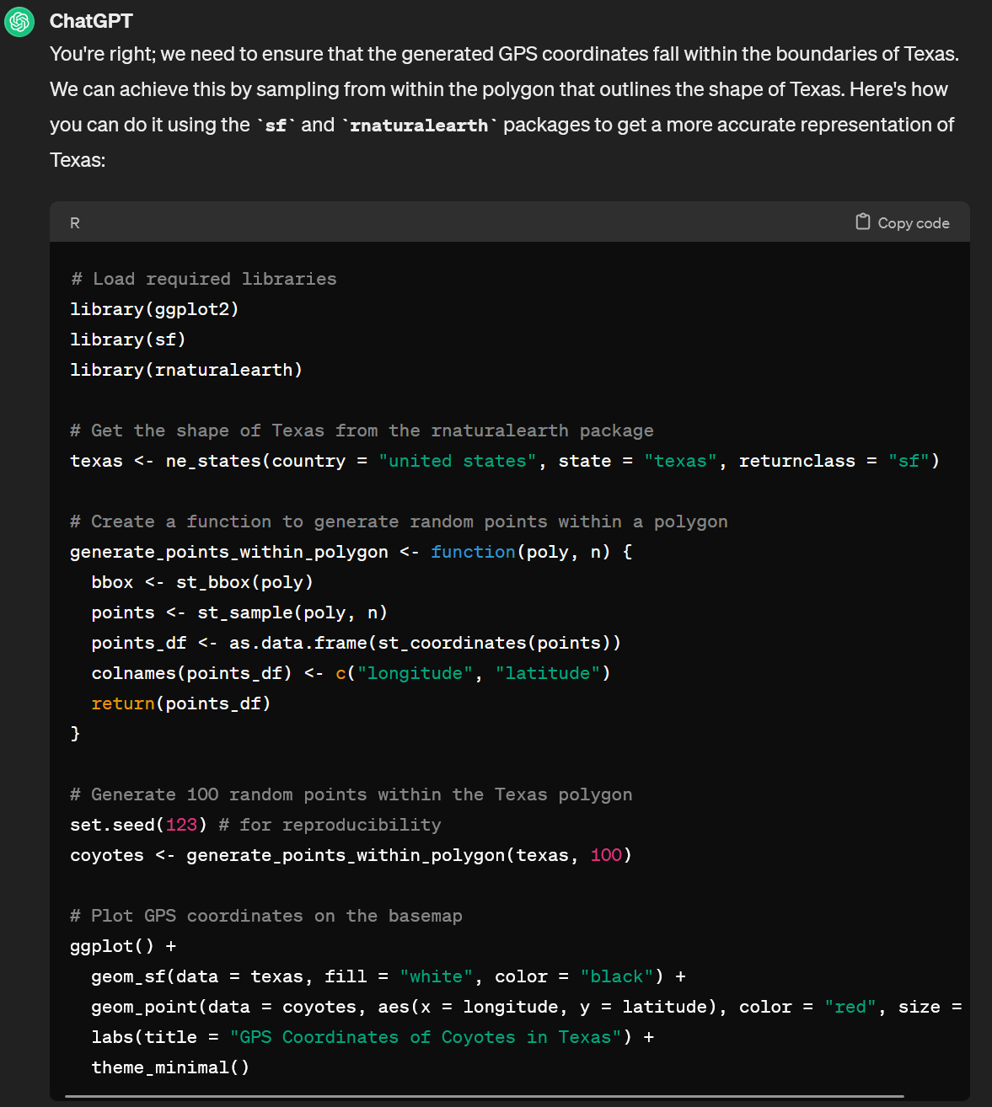
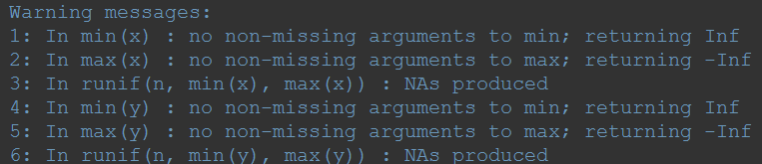
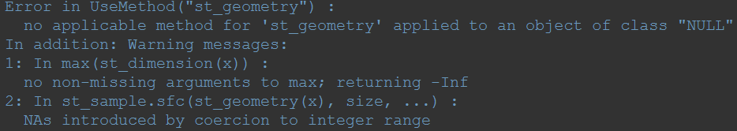
Chat GPTAttempt #1.1 – revision
Attempt #1 - FAIL

Slide 10
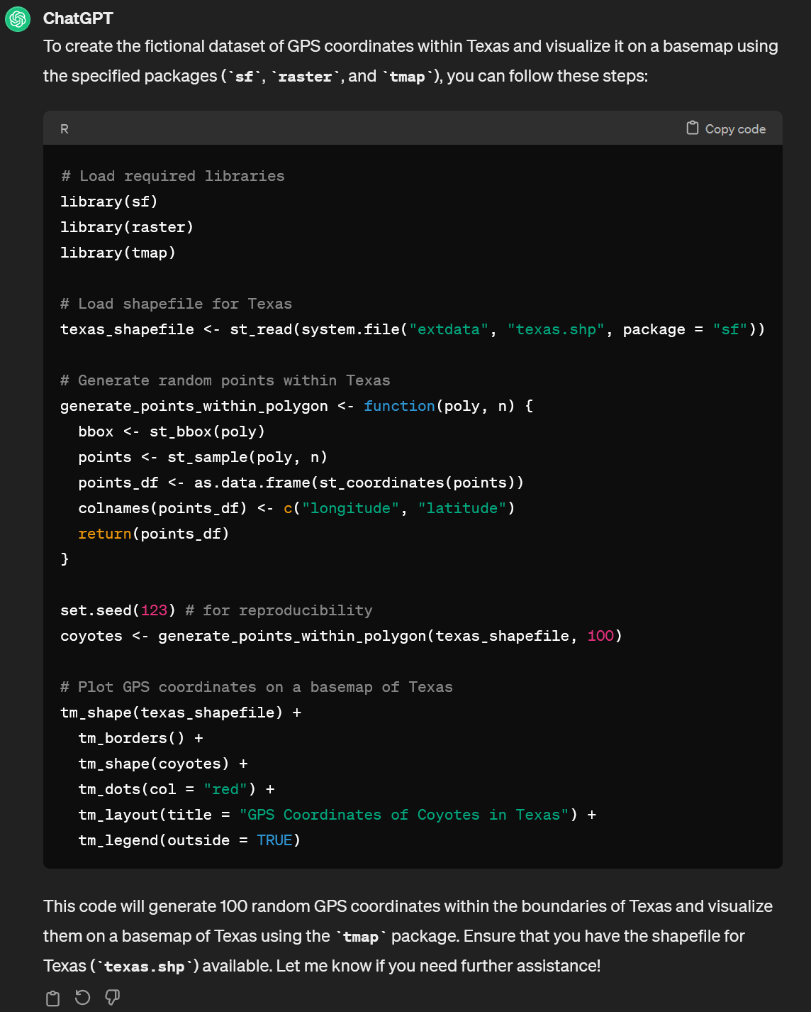
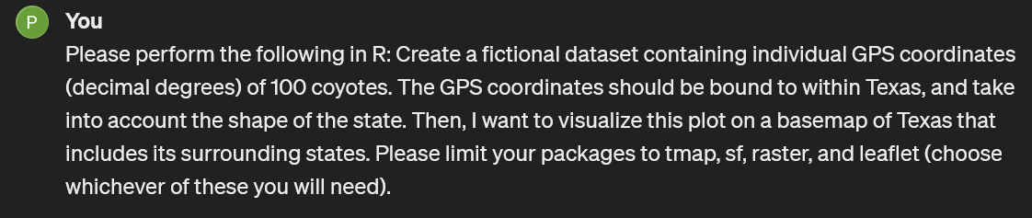
Chat GPTAttempt #2 – packages
Prompt
Response
Problems:
-incorrect use of first function
-need to provide own shapefile
Function incorrect

Slide 11
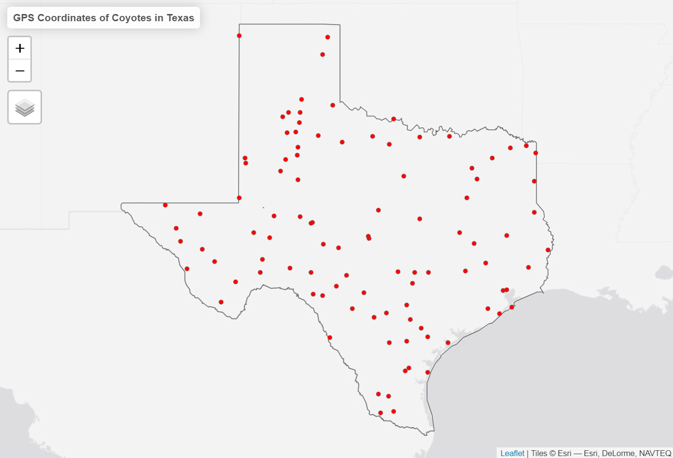
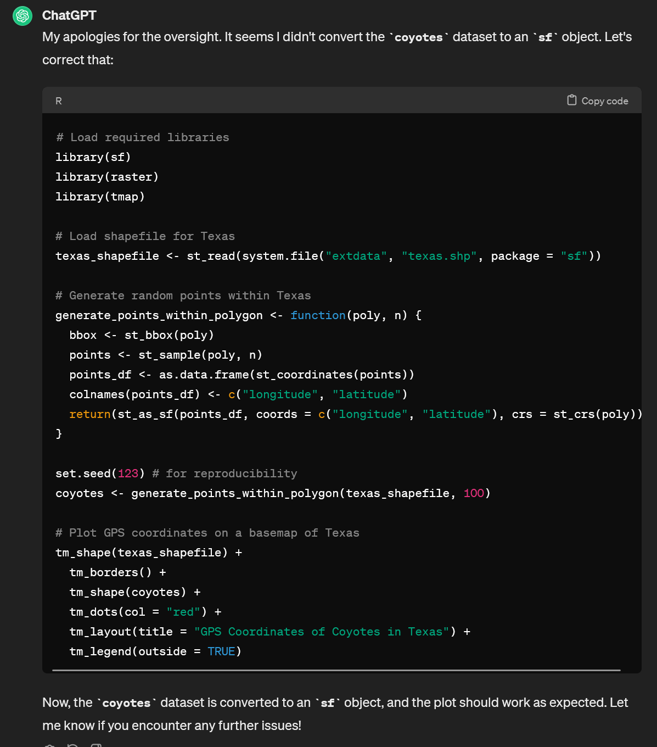
Chat GPTAttempt #2.1 – revision
Prompt
Response
Attempt #2 - PASS

Slide 12
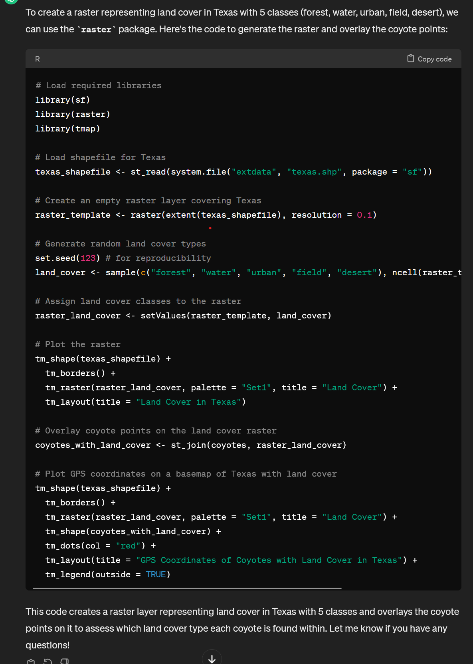
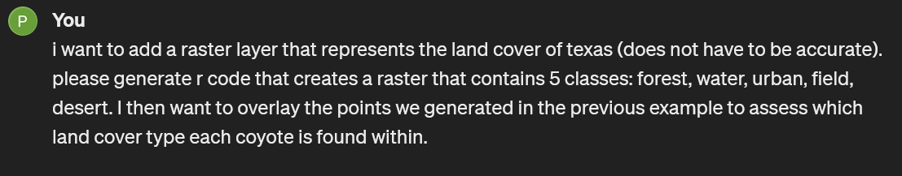
Chat GPTAttempt #3 – improve map
Prompt
Response
Attempt #3 - FAIL

Slide 13
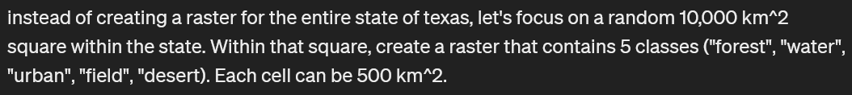
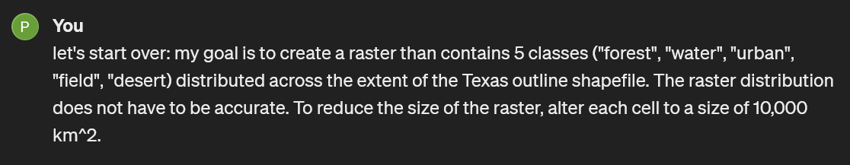
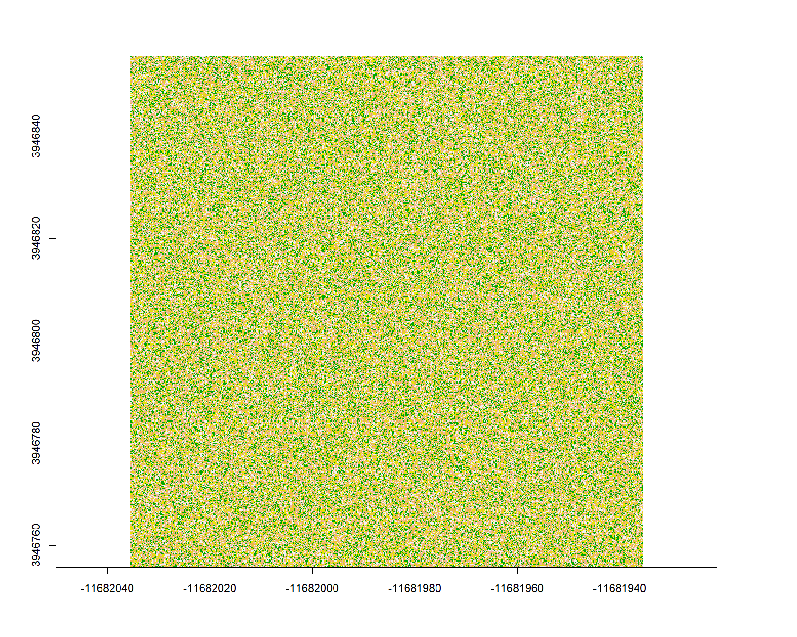
Chat GPTAttempt #4 – Break-up
Prompt
Attempt #4 - PAIL

Slide 14
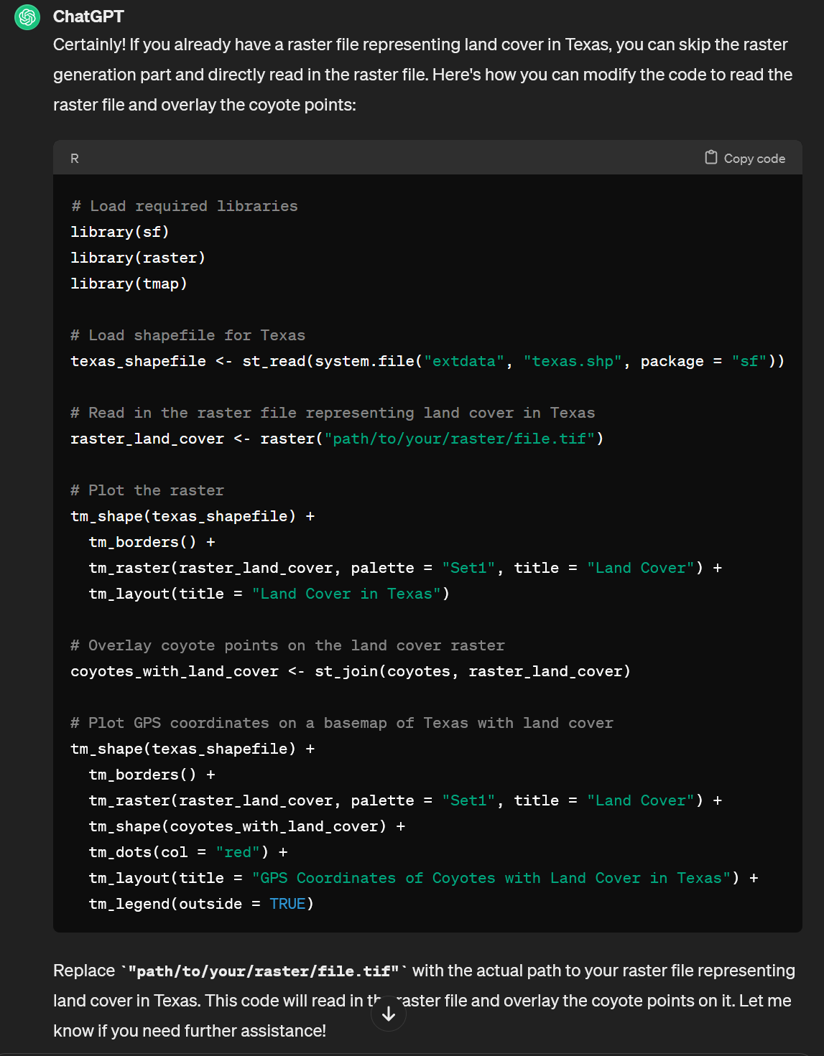

Chat GPTAttempt #5
Prompt
Response
Attempt #5 - FAIL

Slide 15

ChatGPT results
Move to next step / improve visualization
PASS
Specify packages Manual dataset
Specify functions / break up input
Specify packages Manual dataset
Specify packages
No restrictions
Error checking via ChatGPT
FAIL
Revise prompt

Slide 16
ChatGPT limitations
1. Errors pass through multiple iterations unless specifically called out
2. Needed to provide shapefiles AND rasters
3. ChatGPT decision-making

Slide 17
Thank you! Questions?
Photo: Britannica, 2024

